Slide 1

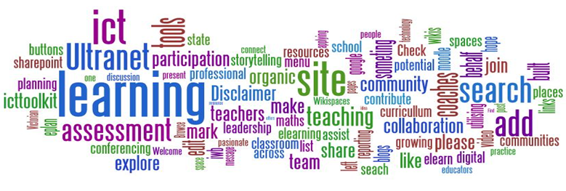
Cambridge TECHNICALS
LEVEL 3
2016
1.5 – Understand ethical and operational issues and threats to computer systems

Slide 2
RELATED ACTIVITIES
e
This Unit | Title of suggested activity | Other units/LOs
LO5 | Ethical issues Operational issues Threats Digital security Safe disposal of data and computer equipment | Unit 2 Global information | LO4 Understand the legal and regulatory framework governing the storage and use of global information LO5 Understand the process flow of information
 |  | Unit 3 Cyber security | O3 Understand measures used to protect against cyber security incident
 |  | Unit 11 Systems analysis and design | LO2 Be able to use investigative techniques to establish requirements for business systems
 |  | Unit 20 IT technical support | LO1 Understand the role of technical support LO2 Be able to diagnose faults and solutions for computer systems LO3 Be able to provide advice and guidance to specific customers
 |  | Unit 22 Big Data analytics | LO1 Understand the scope of Big Data LO2 Be able to process Big Data for business purposes LO3 Be able to provide information resulting from processing Big Data

Slide 3
RELATED ACTIVITIES
e
Explanations of the key terms used within this unit, in the context of this unit
Key term | Explanation
Change management | Change management is a systematic approach to dealing with change, both from the perspective of an organisation and on the individual level. http://searchcio. techtarget.com/definition/change-management
Hybrid cloud | Hybrid cloud is a cloud computing environment which uses a mix of on-premises, private cloud and public cloud services with orchestration between the two platforms. By allowing workloads to move between private and public clouds as computing needs and costs change, hybrid cloud gives businesses greater flexibility and more data deployment options. http://whatis.techtarget.com/definitions/H/page/7
Hypervisor | A hypervisor is a hardware virtualisation technique that allows multiple guest operating systems (OS) to run on a single host system at the same time. The guest OS shares the hardware of the host computer, such that each OS appears to have its own processor, memory and other hardware resources. A hypervisor is also known as a Virtual Machine Manager (VMM). http://www.techopedia.com/definition/4790/hypervisor
Internet of Things | The Internet of Things (IoT) is a computing concept that describes a future where everyday physical objects will be connected to the Internet and be able to identify themselves to other devices. http://www.techopedia.com/definition/28247/internet-of-things-iot
Privacy filter | A privacy filter is a panel or filter that is placed over a display to make it difficult or impossible for someone to see the screen without being directly in front of the display. http://www.computerhope.com/jargon/p/privfilt.htm
RFID | Radio-Frequency Identification (RFID) is a system used to track objects, people, or animals using tags that respond to radio waves. RFID tags are integrated circuits that include a small antenna. They are typically small enough that they are not easily noticeable and therefore can be placed on many types of objects. http://techterms.com/definition/rfid
Social engineering | Social engineering is a non-technical method of intrusion used by hackers that relies heavily on human interaction and often involves tricking people into breaking normal security procedures. http://searchsecurity.techtarget.com/definition/social-engineering
VoIP | Voice over Internet Protocol (VoIP) is a technology that allows telephone calls to be made over computer networks like the Internet. http://compnetworking.about.com/cs/voicefaxoverip/g/bldef_voip.htm

Slide 4
Assignment Scenario
There are 6 sections to this Theory Unit, each of which will give you a basic understanding and practice at possible exam questions. It will involve gaining knowledge towards the answers.
This is not a wrote learning course, you will need to understand the basics of ICT in order to adapt your knowledge towards companies and their needs. For LO5, this will involve understanding:
Ethical issues
Operational issues
Threats
Digital security
Safe disposal of data and computer equipment
In the exam you will be given precise questions requiring precise answers based on a scenario to answers questions from, and adapt your knowledge and use the key terms and named components to give a judgemental answer.

Slide 5
5.1 – Ethical Issues
Morals means your own personal line in the sand, not a legal line but something you will and will not do. Ethics is the acceptable nations line in the sand.
For example, morally if you found a purse on the ground you would try to return it. Ethically people do not generally jump queues or shout abuse at public servants.
There are a lot of legal issues in ICT that have to be abided by, a lot of Ethical issues that should be abided by and a lot of moral stand people do abide by. The separation from these is important but legally it is rarely judged.
For example, download one file from a file sharing site and they almost probably, will not come looking for you. But the fear of this ‘almost probably’ scenario is enough to deter a lot of people.
Ethically a nation will watch something online like football knowing that it is against the law but technically they are not taking the program, they are ‘borrowing it’ for a short period of time.
Task 1: Would you click on a link if it looked interesting but a bit dubious.
Would you return a pound coin, 5 pound note, ten pound note, twenty. Where is your moral line in the sand.
Would you download a movie that has been on TV. Discuss.
Morals means personal responsibility, ethics means a nations moral responsibility If you store one music file you are breaking the law. Watching something in a room with more than 5 people without licence is breaking the law Singing a song out loud is breaking the law. Find one student in the room who is not breaking the law.

Slide 6
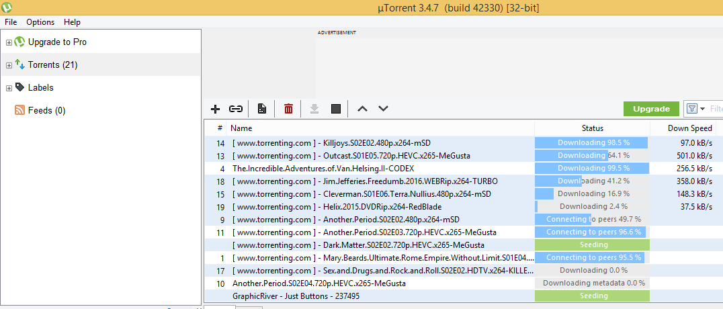
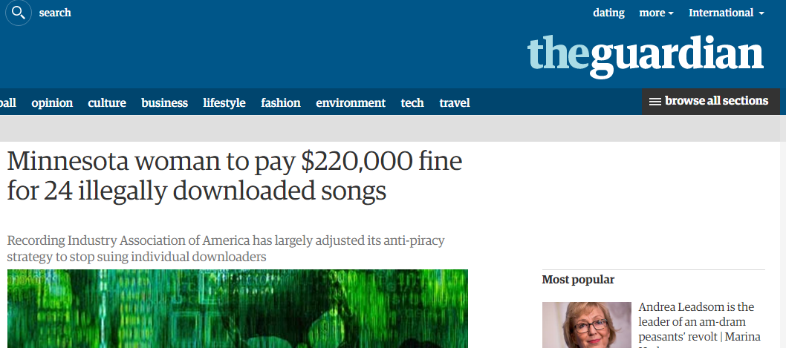
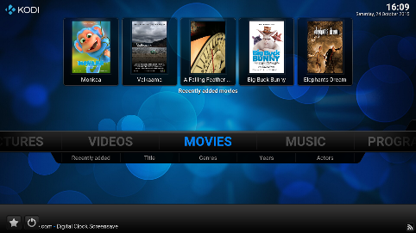
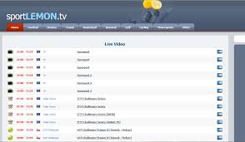
5.1 – Moral Use of ICT – File-sharing
American student Joel Tenenbaum was taken to court for downloading and sharing songs using the peer-to-peer file sharing program Kazaa. Under US law, recording companies are entitled to $750 to $30,000 per infringement, or more if the jury believes the infringements were wilful.
In the first case of this kind, a Minnesota jury awarded $80,000 per song, amounting to $1.92 million for sharing 24 songs. Joel was found guilty and ordered to pay $675,000 (£404,000). He now must either pay the fine or declare bankruptcy. Tenenbaum said an entire generation has grown up downloading music and his case is not unusual, but in a press release, Recording Industry Association of America President Mitch Bainwol said music fans know right from wrong when it comes to illegal downloading.
Task 2 – Discussion:
Do you think the ruling was fair?
Do you think the law upon which the ruling was based is fair? If so, explain why. If not, what alternatives could you suggest?
Do you think this is the best way to deter piracy?
SCENARIO
You’re out for a meal with a family friend who works in an independent TV production company. She isn’t happy: unless the TV series that they’ve just released on DVD sells well, the company is going to have to make cutbacks – which might include her. You realise that that’s the TV series that you’ve been downloading via a file-sharing site for the past couple of days.
Task 3 - What do you say to her? What do you do about the downloads when you get home? Discuss.

Slide 7
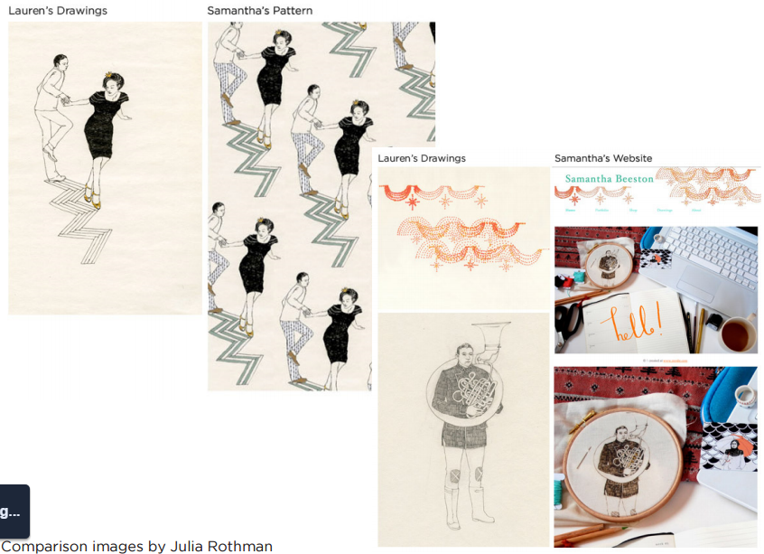
5.1 – Moral Use of ICT – Plagiarism
Lauren Nassef is a freelance illustrator living in Chicago. She showcases her work on her website, laurennassef.com. On the 3rd of August 2009 she was alerted by a visitor to her website that a graduate student at Falmouth University named Samantha Beeson had stolen her drawings and used them in her own work.
As well as using the pieces for her degree work, Samantha won a £750 award and the opportunity to showcase her designs at exhibitions in Hong Kong and Paris. She even included Lauren’s drawings on her own web portfolio, which she has since taken down, and made a fake sketchbook with Lauren’s drawings traced or pasted in. Illustrator Julia Rothman said:
“I’m not sure what the lesson here is.
Should we be more careful about putting
our work online? How can we protect
ourselves from incidents like this?”
Task 4 - Why do you think the student
copied Lauren’s work?
What do you think the repercussions
will be, now that she has been found out?
How do you think Lauren might feel about
continuing to share her work online?

Slide 8
5.1 – Moral Use of ICT – Plagiarism
Many students will admit to having copied sections of a web page and submitting it as homework. This problem isn’t just confined to school classrooms.
Recently there has been a worrying growth in university students to copying from the internet. Many lecturers now have access to software that can recognise copied work. Many students have been caught, some even failing their degrees. Faced with the near certainty that the cut-and-paste essay will be found out, lazy or dishonest students can now turn to websites that offer to write their essays for them, and, in every case, guarantee that the essays are original.
These websites defend themselves by saying that the essays are only provided as a model answer and should not be submitted by the student as their own work. However, how many people really believe that a student is going to pay hundreds of pounds for a customised essay and then not take the easy option of using it as it stands?
Task 5
Do you think plagiarising information has an impact on learning, or is it just another way to work?
How do plagiarism detection tools like turnitin work?
Do you think ‘grades for pay’ are a fair way of working?
How could this be stopped?

Slide 9
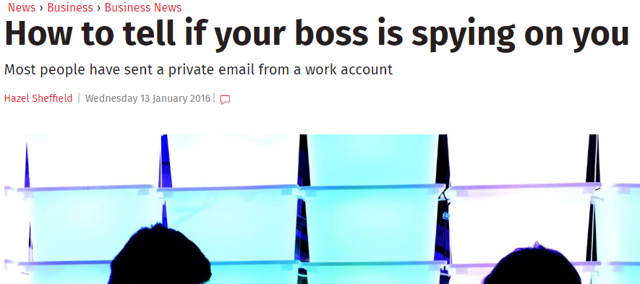
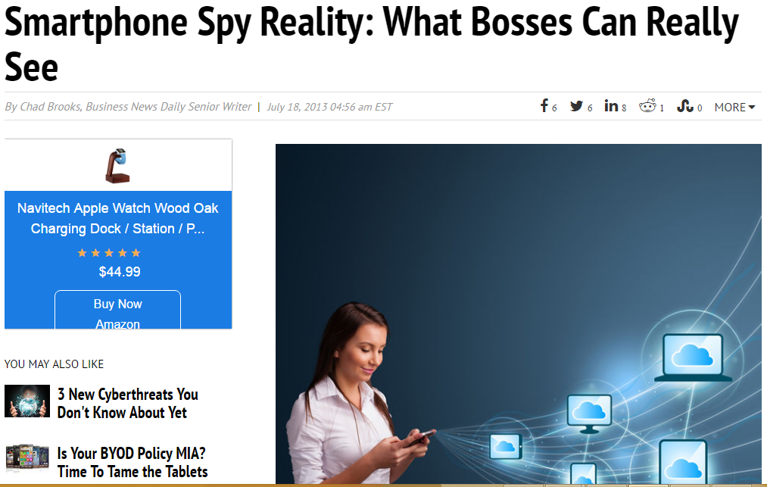
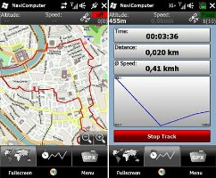
5.1 – Moral Use of ICT – Snooping
A survey by Cyber-Ark suggests the global slump is prompting IT staff to snoop on their colleagues. 35% of those questioned had viewed confidential information without permission, including salary information & redundancy lists. 74% of those questioned said they could get round the controls securing this data. Many admitted they would steal information from businesses if they were fired.
The most popular targets for those planning to steal information were copies of customer account databases, passwords for an email admin account and merger plans. The responses suggest the security measures in place to prevent abuse were insufficient. Cyber-Ark CEO Udi Mokady said: “Businesses must wake up and realize that trust is not a security policy.”
Task 6
Why do you think information is becoming a target for employees?
Is this as serious as stealing hardware?
What can be done to prevent employees from snooping?

Slide 10
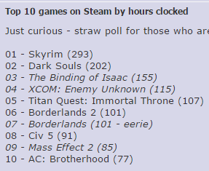
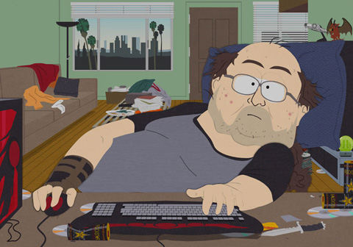
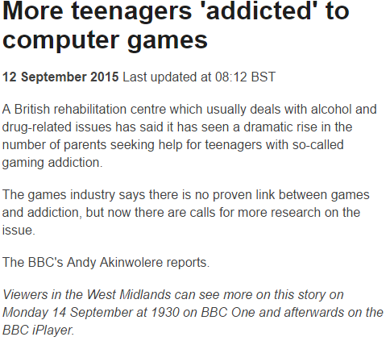
5.1 – Moral Appreciation of ICT – Addiction
Gaming addiction – We covered the social problems with this under social, but psychological damage caused by gaming addiction can be as severe. This can be linked to aggressive behaviour as well. Compulsive obsessive behaviour of some variety is in all of us, how this manifests itself can differ. Gaming and gambling for example are linked. The victories on levels is similar to the victory of a poker win, death in a game is similar to defeat in a poker game. It is games like RPG’s that get the most blame for this. Levelling up feels like a rush, feels like a personal achievement, now you are bigger, stronger, faster, like a poker win, now you can spend more, ease off, be more aggressive because you have a stake.
The world does not see Computer addiction as worrying as other addictions because it does not affect others in the surrounding circle as much as other addictions. For example, £40 per game is nothing to most people, £10 for an add on, more downloadable content. And a game might only have 40 hours of play before completion, an addicted gamer might go back and play again but still only 40 hours. They lose sleep but still sleep, the do not eat as much but still eat, games can be paused, gambling cannot so easily.
More importantly it is not seen as an issue because parents think they can manage their children’s gaming addiction, turn the machine off, switch off the Internet, disable accounts, send them to school and limit their home use. Arcades used to be the external outlet but they are mostly dead now or limited to classics.

Slide 11
5.1 – Moral Appreciation of ICT – Addiction
Internet addiction is treated as a mental illness in China. Sufferers are sent to training camps where they are subjected to military-style discipline in the name of rehabilitation. Some estimates suggest up to 10% of the country’s 100 million web users could be addicted.
The Chinese government shut down almost 2,000 internet cafes in 2001 because of concerns over the influence of the internet on teenagers. There is little consensus on how to treat the addiction, yet in July China’s Ministry of Health formally banned the use of electroshock therapy.
Fifteen-year-old Deng Senshan’s father saw an advertisement for Qihang Salvation Training Camp on TV, and decided to send his son to the camp. Less than 24 hours after arrival, Deng was put in solitary confinement and beaten. Deng was later found vomiting and taken to a clinic, where he died. Several marks were found on his body.
Task 7
Why might China feel so strongly about its young citizens spending time online?
Research into China’s internet history, and the “great firewall of China”. Think about your own internet access. Are you addicted?

Slide 12
5.1 – Ethical Appreciation of ICT – Health
One of the biggest arguments against the gaming world has been linked to health levels. Kids are sitting around all day playing games, not moving, eating in front of the game for hours at a time, repeating the same key presses and movements and not getting out. This argument has been around since the first mass produced home computer and the Atari VCS console. And the argument is likely to continue even with more interactive methods of controllers. Remembering that 80% of newspapers are aimed at parents and adults who play a lot less games than teenagers and children.
Obesity – The main argument, studies show calorie counts, studies show blood flow, amount of movement, amount of static siting around. We all know gaming does not make you fit, not really. Neither does driving, working at a desk, standing behind a counter which 60% of the working population does. “But it is a choice, work is not.” The argument against is that games do not make people obese, eating and lack of exercise does.
Between 2004 and 2012 according to the Pittsburgh Gazette, childhood obesity in America went up by 30%. This was linked to gaming as the gaming industry and the amount of homes with consoles has gone up substantially in comparison. Childhood obesity is then linked with heart disease, cancers, arthritis, thyroid inflammation, diabetes and depression. All things that can be a burden on the health service. Whether this is true is another matter but it is good to have something to blame.

Slide 13
5.1 – Ethical Appreciation of ICT – Health
Fitness – Linked to obesity, the fitness levels of children has been seen to drop in the last twenty years and naturally Gaming and the withdrawing from socialisation has been blamed. With the introduction of Wii Fit, the newspapers grabbed this as a new age of interactivity and promise, families playing tennis in front of the televisions, running on the Wii board, boxing and jumping about on the Kinect etc. Parents see their children playing Fifa and say they should get out there and play it for real but there is almost as much Football, Cricket, Gaelic, Baseball etc. being played as there ever was.
RSI in young people is rare but starting to become more evident as the need to play more games, to sit in front of a console and repeat the same actions over and over again is growing. 69% of all primary wage earners play some type of video game, Hours of limited movement or immobility prevents proper blood flow to the extremities, constant staring at the screen can impair your vision, and even the curvature of the spine can also be affected.
The most common injuries doctors see on a regular basis are repetitive stress injuries, or RSIs, of the thumbs, hands and wrists. These injuries are so common now that they have been given their own names in the dictionary of medical terminology; “texting thumb” and “nintendinitis” are just two of the RSIs created by modern technology.

Slide 14
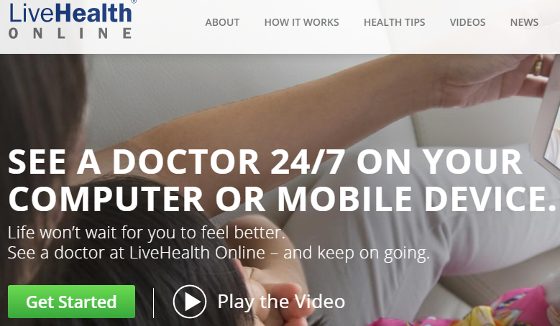
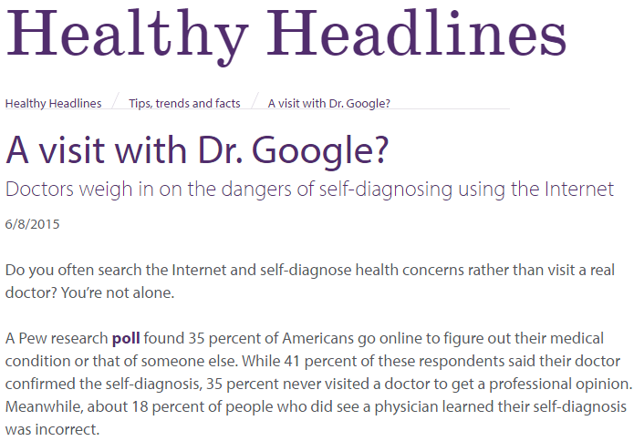
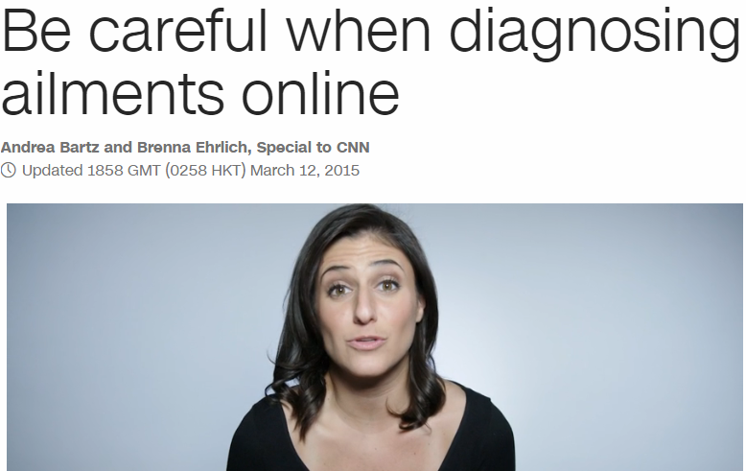
5.1 – Ethical Appreciation of ICT – Web Medicine
No one likes going to visit the doctor and with today’s increasingly busy lifestyles, trying to find the time to make an appointment with your GP can be difficult. This has perhaps been compounded by the growth in medical self diagnostic internet sites. Simply enter a list of your current symptoms into the online database and within seconds you will receive a ‘medical diagnosis.’
Being able to put your mind to rest at 3am, realising that you probably have a bad bout of wind rather than appendicitis can be a very good thing. However, such sites should be used with caution because there is a danger that a serious illness could be misdiagnosed by the online ‘medical expert’
Task 8
How accurate do you think these sites can be with their ‘diagnosis’?
What are the potential risks to a patient if the site mis-diagnoses their symptoms?
What are your views on such sites ultimately being there to make money from people who visit them?

Slide 15
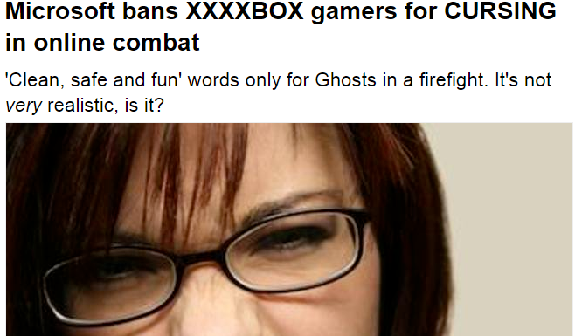
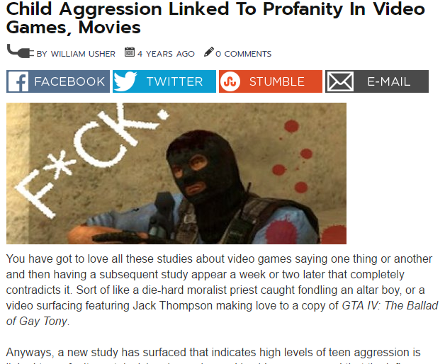
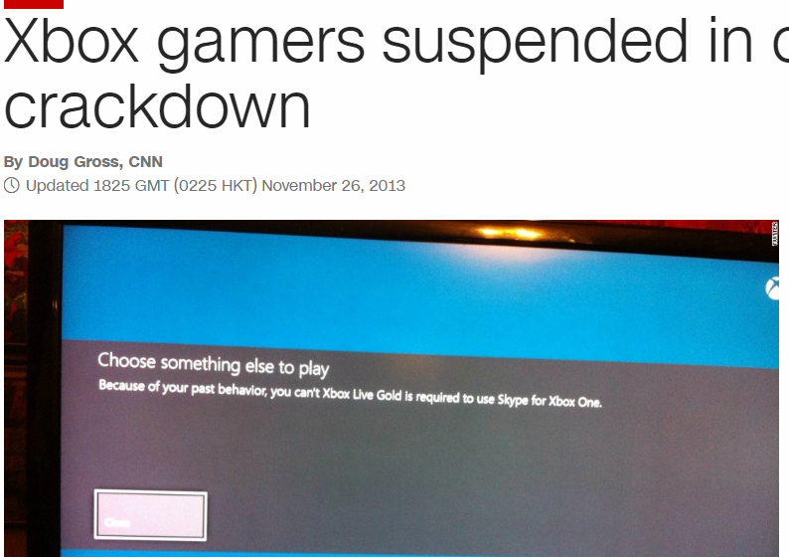
5.1 – Cultural Appreciation of ICT – Global World
Global play – Before online play users bought the games, played the games, put the games back in their boxes and that was that, little or no external interaction except talking to friends about it, which armour in Skyrim they preferred or how many little soldiers they collected in FF7. Online play has been the unique selling point since Xbox360 and PC’s before that. Breaking down country barriers, playing against people from nations around the world, teaming up against other countries, joining a game with a thousand users. The next generation of RTS will have ten thousand users in different teams fighting a war against each other. It is what the gaming industry has always wanted, a captured world audience.
The downsides of this include government blocking. In countries where Twitter is illegal, free speech through online play will be monitored for similar reasons. Similarly Global Play and anonymity can lead to Trolling and Grooming, at least the press believes so. There are arguments for and against, the biggest being that the world is not ready for the breaking down of cultural, physical and religious barriers that the freedom of net play offers.

Slide 16
5.2 – Operational Issues
Within every organisation there are issues with staff that need to be addressed, specifically due to the increased use of ICT in the workplace. These operational issues can have an impact on moral, safety and the way staff perceive working conditions.
Security
Health and safety
Disaster planning
Organisational issues
Change management
Scale of change.
Change within the ICT world happens Built in redundancy Why do schools not replace Base machines with Laptops How can Thin Client reduce change issues Can a student sue over Health and Safety at school. What is an AUP policy What’s the harm downloading at school Why is Facebook blocked

Slide 17
5.2 – Operational Issues - Security
Change within the ICT world happens Built in redundancy Why do schools not replace Base machines with Laptops How can Thin Client reduce change issues Can a student sue over Health and Safety at school. What is an AUP policy What’s the harm downloading at school Why is Facebook blocked
Personnel screening
Invasions of privacy, virus introduction, malicious destruction of data
Natural disasters and accidents
Operational security
Communications security
Authorisation software
Terminal use controls
Building security
IT SYSTEMS AND
DATA
Errors in programming, input and output procedures, operations
Espionage, fraud and theft, threats, blackmail
Guards, Ids, Visitors passes, sign in/out
Locks, swipe cards, biometric measures (e.g. fingerprint recognition)
Access rights (e.g. no access, read-only, read-write)
Automatic callback, encryption, hand-shaking procedures
Audit trails, unusual patterns of use, virus checks, backup and recovery procedures
Hiring policies, separation of duties, education and training, establishing standards of honesty

Slide 18
5.2 – Operational Issues - Security
The most secure method of prevention against theft and damage within ICT are physical measures that are taken, seen and unseen. Under the DPA, all possible measures within reason must be taken to secure confidential information. These can include:
CCTV – Internally and externally, it is common to have these on buildings but companies also have them in the network room, the corridors, reception and wherever there is money stored. Some have motion sensors so they record as soon as there is movement.
Locks – Standard locks on doors are usual, in most buildings staff rooms have locks. Network rooms particularly have locks, all entrances and exits. But network server cupboards and racks have locks, laptop cabinets, filing cabinets and keys allocated only to those who have rights. These locks can be keys or numbered.
Key cards – These are more secure as they record access and log times. They are more difficult to fake and can be cancelled electronically is lost or stolen unlike keys.
Change within the ICT world happens Built in redundancy Why do schools not replace Base machines with Laptops How can Thin Client reduce change issues Can a student sue over Health and Safety at school. What is an AUP policy What’s the harm downloading at school Why is Facebook blocked

Slide 19
5.2 – Operational Issues – Security Planning
Planning is the first step to protecting a network system against attacks, pre-empting the dangers that can happen and setting network software and hardware controls to limit these attacks. On a network this can takes several forms:
Logging, evidence gathering - This can be done through auditing software built into windows or Novell Client that keeps a track of every IP address access, logging dates, times, length of activity, MAC addresses, websites successfully viewed and matches these against user names. From an external attack these can register MAC and IP addresses of machines in order to set up blocks. The school does this in the form of Network Logs. An example of a log can be seen at: http://manuals.kerio.com/kpf/en/ch16s04.html
Predetermine countermeasures - For example, use Checkpoint's “OPSEC" standard and their Suspicious Activity Monitoring Protocol (SAMP) to dynamically configure firewalls. Firewalls are the main defense against external attacks, the stronger the firewall the better the defense. Configurable firewalls can limit the damage further based on previous attacks but firewalls are not a good defense against internal attacks.
Counterstrike (disable attacking host) - This is an aggressive policy where the attacker counter measures on the one connection and disables the host with similar tactics. If this is a single attacking host this can disable their account, their external links or their ability to attack.
Honeypots – this can be as aggressive as Counterstriking and set a door access and trap for hackers to get in therefore gaining an IP address or Host address of the attacker in order to disable them. This can be provoking, wasting their time and can force them to be more aggressive in return.
Change within the ICT world happens Built in redundancy Why do schools not replace Base machines with Laptops How can Thin Client reduce change issues Can a student sue over Health and Safety at school. What is an AUP policy What’s the harm downloading at school Why is Facebook blocked

Slide 20
5.2 – Operational Issues – Disaster Planning
Planning is everything and disaster planning is essential, specifically in larger companies. There are three levels of risk:
Small – Network Crash, DDOS attack, corrupted hard drive, hack or virus.
Medium – Major hack, fire, corruption of backups
Large – Earthquake, disaster, continued attack, e.g. Sony and Kyoto.
All these can be secured with simple backups. Having data backed up is the cornerstone of any disaster recovery plan. Without backups, a simple hard drive failure can set your company back days or even weeks. In fact, without backups, your company’s very existence is in jeopardy. For schools this is a legality and three backups are necessary, nightly, weekly and off site copy.
The main goal of backups is simple: Keep a spare copy of your network’s critical data so that, no matter what happens, you never lose more than one day’s work. The easiest way to do this is to make a copy of your files every day. If that’s not possible, techniques are available to ensure that every file on the network has a backup copy that’s no more than one day old.
The goal of disaster planning is to make sure that your company can resume operations shortly after a disaster occurs, such as a fire, earthquake, or any other imaginable calamity.
The most common media for making backup copies is a tape ➔ up to 80GB of data.
All versions of Windows come with a built-in backup program.
Change within the ICT world happens Built in redundancy Why do schools not replace Base machines with Laptops How can Thin Client reduce change issues Can a student sue over Health and Safety at school. What is an AUP policy What’s the harm downloading at school Why is Facebook blocked

Slide 21
5.2 – Operational Issues – Disaster Planning
Normal backups - also called a full backup (most basic type of backup), where all files in the backup selection are backed up — regardless of whether the archive bit has been set. As each file is backed up, its archive bit is reset, so backups that select files based on the archive bit setting won’t back up the files.
Copy backups - similar to a normal backup, except that the archive bit is not reset as each file is copied. As a result, backups don’t disrupt the cycle of other backups
Daily backups - backs up just those files that have been changed the same day that the backup is performed. A daily backup examines the modification date for each file to determine whether a file should be backed up. Daily backups don’t reset the archive bit.
Incremental backups - backs up only those files that you’ve modified since the last time you did a backup ➔ a lot faster than full backups because your network users probably modify only a small portion of the files on the server in any given day.
Differential backups - A differential backup is similar to an incremental backup, except that it doesn’t reset the archive bit as files are backed up. As a result, each differential backup represents the difference between the last normal backup and the current state of the hard drive. To do a full restore from a differential backup, you first restore the last normal backup, and then you restore the most recent differential backup.
Change within the ICT world happens Built in redundancy Why do schools not replace Base machines with Laptops How can Thin Client reduce change issues Can a student sue over Health and Safety at school. What is an AUP policy What’s the harm downloading at school Why is Facebook blocked

Slide 22
5.2 – Operational Issues – Organisational Issues
Procedures and Analysis - Every company that uses computers, email, the internet, and software on a daily basis should have information technology (IT) policies in place. It is important for employees to know what is expected and required of them when using the technology provided by their employer, and it is critical for a company to protect itself by having policies to govern areas such as personal internet and email usage, security, software and hardware inventory and data retention. It is also important for the business owner to know the potential lost time and productivity at their business because of personal internet usage.
Without written policies, there are no standards to reference when both sticky and status quo situations arise, such as those highlighted above.
So, what exactly are the IT policies that every company should have? There are six areas that need to be addressed:
Acceptable Use of Technology: Guidelines for the use of computers, fax machines, telephones, internet, email, and voicemail and the consequences for misuse.
Security: Guidelines for passwords, levels of access to the network, virus protection, confidentiality, and the usage of data.
Disaster Recovery: Guidelines for data recovery in the event of a disaster, and data backup methods.
Technology Standards: Guidelines to determine the type of software, hardware, and systems will be purchased and used at the company, including those that are prohibited (for example, instant messenger or mp3 music download software).
Network Set up and Documentation: Guidelines regarding how the network is configured, how to add new employees to the network, permission levels for employees, and licensing of software.
IT Services: Guidelines to determine how technology needs and problems will be addressed, who in the organization is responsible for employee technical support, maintenance, installation, and long-term technology planning.
Change within the ICT world happens Built in redundancy Why do schools not replace Base machines with Laptops How can Thin Client reduce change issues Can a student sue over Health and Safety at school. What is an AUP policy What’s the harm downloading at school Why is Facebook blocked

Slide 23
5.2 – Operational Issues – Organisational Issues
On a larger scale, company IT policies tend to be standard across sites, the same IT policy in Subway in Chislehurst will be the same as the Subway in Ballymena, Corby, Glasgow. The risks are the same, the policies vary slightly depending on the nature of the business, the information the company manages and the security threats that have been successful or attempted from the past.
Staff at these companies will be aware of these policies, specifically when it comes to more sensitive information. Most companies get their staff to sigh an AUP, Acceptable Use Policy. In schools there should be one by the door to every classroom that has a computer.
Companies write these to protect themselves and their customers. Using two policies you will need to analyse, compare and review these based on a range of criteria that needs to be set.
Change within the ICT world happens Built in redundancy Why do schools not replace Base machines with Laptops How can Thin Client reduce change issues Can a student sue over Health and Safety at school. What is an AUP policy What’s the harm downloading at school Why is Facebook blocked
Bath University | Co-op | Greggs
Princeton University | Asda | McDonalds
MIT University | Morrisons | Subway

Slide 24
5.2 – Operational Issues - Policies and Procedures - Policies
Policies are there to protect customers information, staff details and to protect the company. Writing a policy document makes it legal. All new staff read these and sign an agreement that they understand it. Then it become official. They breach the policy, they signed the agreement. They download at work, they signed the agreement, they look at things they should not, you can see where this is going. Companies need to be protected, policies need to be updated when things change so the company remains protected.
And everyone is affected. When a student starts a school they sign the agreement, or their parents do, as do staff. This means we follow etiquette, we do not download, we do not abuse the emails, we do not look at inappropriate materials on the internet. Lowest case scenario is a verbal or written warning, or the facility is blocked, email is suspended. And as all emails and Internet traffic is monitored with a produced log and Internet trail, and as we know this, we abide by the rules.
Click here for statistics on why these policies are necessary.
Task 9 – Using 2 different business models and the Report Template, define the Policy Purpose and Policy Audience.
Policy Purpose |  | Policy Audience
Business 1 | Business 2 | Business 1 | Business 2

Slide 25
5.2 – Operational Issues – Password Procedures
While Usernames will be considered public information, passwords are the first line of defence at providing for computer and information security. It is inevitably the individual’s responsibility to maintain the security of their password while maintaining a certain level of complexity within that password as not to allow for breeches of that Username. Usernames and password management is a significant part of an overall solution to improve security. The overall protection of the key assets must begin with the individual who has access to them.
Policies outline how Usernames will be created and how a user will be required to choose a password that is considered to be strong given best practices as they exist currently. Additional requirements are usually outlined in policies as will the creation of default passwords, changing of passwords, and resetting of passwords. Each user of computing resources is expected to stick to their company policy.
Click here for statistics on why poor policies with passwords.
Task 10 – Using 2 different business models and the Report Template, define the Companies Policy on Passwords procedures.
Guidelines on User names |  | Guidelines on Passwords
Business 1 | Business 2 | Business 1 | Business 2

Slide 26
5.2 – Operational Issues - Policies and Procedures – Cyber Bullying
Company policies are designed for a reason and the one particular danger that companies always come up with is the effective and abusive use of emails at work. There are two dangers involved in these, those who use emails trivially and those who use email maliciously. Company policy tries to limit the first and demands a halt to the second.
Ineffective use of emails can include sending trivial emails on company time, sending materials that are wrong, images, comments, slanders, using bad language, using inappropriate layouts and manners when sending emails to customers. Etiquette, restrictions and monitoring can manage these.
Malicious use of emails is more dangerous, cyber bullying, threatening behaviour, the spreading of materials such as images, viruses, leaked information, malware etc. These are harder to stop as the emails are already internal but they can cause damage to the company, prosecutions, reputations being lost. Click here and here for the damage though inadvertent use.
Task 11 – Using 2 different business models and the Report Template, define the Companies Policy on Email procedures.
Ineffective use of Emails |  | Malicious Use of Emails
Business 1 | Business 2 | Business 1 | Business 2

Slide 27
5.2 – Operational Issues - Procedures – Email Procedures
Cyber Bullying is common in the outside world, emails, texts, Facebook comments, tweets etc., it is very easy to get and use IT for these purposes. There are news articles all the time that pick up on these. Policies within businesses are written to limit this down, when someone prosecutes, a company can become involved if it happens in the workplace and is not dealt with. The workplace is a hotbed of tensions, of personalities and potential problems. It is in the companies best interest to reduce down their involvement in this.
Monitoring is the simplest ICT method, all emails and stored, all internet activity monitored, audit trails and network logs will track all internet activity that goes through the system. Company phones and conversations with clients, customers and suppliers are recorded etc. this constant monitoring and pervasive tagging may seem over the top but it works, staff who are afraid of getting caught will limit their activities.
Click here and here for examples of how cyber bullying can affect the reputation and finances of a company.
Task 12 – Using 2 different business models and the Report Template, define the Companies Policy on Cyber Bullying and tracking procedures.
Cyber bullying |  | Activity Tracking
Business 1 | Business 2 | Business 1 | Business 2

Slide 28
5.2 – Operational Issues - Policies and Procedures – Access Privileges
Within every company there is sensitive information, staff details, customer details, reports, staff reviews, medical information and other information that needs to be protected under the Data protection Act. This is a given, information needs protecting but sometime sit also needs to be seen and not changed. Access privileges are set on two levels, staff rights of access and file rights of access.
For staff, limiting down folders, hiding information, storing things in different locations etc. this makes it more difficult to illegally or accidentally access, giving staff access privileges such as read rights, copy rights, and delete rights set the network controls on how those files are seen and read. For instance the network manager can see everything because they need to set the rights but is bound by a code of confidentiality, a standard office worker can see some customer information but only through granted access as related to their job. Abusing this privilege or attempting to access materials above their pay grade is considered a breach of the Computer Misuse Act.
Click here and here for examples of how abusing access privileges can affect the reputation and finances of a company.
Task 13 – Using 2 different business models and the Report Template, define the Companies Policy on Access Privileges procedures.
Access Privileges
Business 1 | Business 2

Slide 29
5.2 – Operational Issues - Policies and Procedures – Backup and Disaster Recovery
Backups are vital within a company and disaster recovery plans are linked to the levels, depth and location of these backups. To lose a connection for a minute for some companies can be annoying, possibly expensive, to be down for a day can cause a serious drop in profitability, to be down for a week will break a lot of companies. This is why businesses draw up a disaster recovery plan, and why backing up information, hourly, nightly and weekly is vital to this.
How fast a company can recover its systems is the key to this, PSN network was down for several days costing the company in the range of $18bn in reputation and compensation, RBS set aside £125m because of its ICT loss in February 2013. The IT disaster recovery plan after the Kobe Earthquake in 1995 was immense, a similar earthquake like March 2011 was less expensive because companies planned for it, had backups, had external sites, had cloud and network storage. For some companies the recovery time was hours.
By law, schools backup their files nightly and weekly, keep a backup in a fireproof safe and store a copy of the network off-site. Think of what a large company with a turnover of 100 times a school will need to do.
Click here and here for examples of how abusing Backup and Disaster Recovery can affect the reputation and finances of a company.
Task 14 – Using 2 different business models and the Report Template, define the Companies Policy on Backup and Disaster Recovery procedures.
Backup Policy |  | Disaster Recovery Policy
Business 1 | Business 2 | Business 1 | Business 2

Slide 30
5.2 – Operational Issues - Policies – Network Security and Policies
Every new employee signs an AUP agreement, even if they do not physically write it down, all companies with computers have them. The physical and software security on a network is designed to almost all of the breaches that might happen. There are programs installed on most systems that help this, Novell Client, IIS, IP addressing, Login names and passwords, Firewalls, Virus Checkers, Proxy server software.
Just having the agreement is half the cure, staff can be fired for computer misuse, they sighed the AUP, they can have their job changed, they signed the AUP, they can have privileges removed, they signed the AUP.
Setting user levels also benefits the network Security, setting protocols and rights of access. And then there is external security, SSL, remote access, restricted service access, limited external access to files and more companies are moving across to cloud security for external files. At the end of the day, any company with more than 20 staff will have a network team that spends their days securing the network, finding new breaches, blocking new gaps, locking down new VPN’s, updating banned logs and monitoring incoming, outgoing and internal network activity.
Click here, here and here for examples of how abusing Network Security and AUP policies can affect the reputation and finances of a company.
Task 15 – Using 2 different business models and the Report Template, define the Companies Policy on Network Security and Policy procedures.
Network Security |  | AUP Policy
Business 1 | Business 2 | Business 1 | Business 2

Slide 31
5.2 – Operational Issues - Policies and Procedures – Physical Controls
Just as policies are in place, computers are locked, windows are protected, software secure, then someone steals the box. Laptops, tablets, phones, memory sticks, portable hard drives, keyboards, mice and even the cables that connect them are at risk. Physical controls vary from company to company depending on the threat and the expense. A school would have locks on the doors, locks on the back of the computer and perhaps smoke alarms and movement sensors in the room. But this is not enough to stop theft or damage and for every computer missing or machine down due to partial or complete damage, there is a loss of business function. So we lock the windows, close the curtain, secure the rooms so no-one is in there without staff presence, security pen mark, infrared marking, we check each room after the lesson is done. But there are still things missing, mice, keyboards, cables unplugged etc.
In larger companies the physical controls also include card swipes, keypad security, fingerprint logins, laptop locks, video cameras, grills, screen protectors, guards, dogs, RFID tracking. Some companies even put silent alarms on the doors that destroy hardware that is removed from the room like banks and cash.
At the end of the day physical prevention and being seen to be preventing is a good deterrent, specifically against opportunist thieves.
Click here, here and here for examples of how abusing Physical Controls can affect the reputation and finances of a company.
Task 16 – Using 2 different business models and the Report Template, define the Companies Policy on Physical Controls procedures.
Physical Controls
Business 1 | Business 2

Slide 32
5.2 – Operational Issues - Policies and Procedures – Asset Management
IT asset management is an important part of any business strategy. It usually involves gathering hardware and software inventory information which is then used to make decisions about hardware and software purchases. IT inventory management helps a company manage their systems more effectively and saves time and money by avoiding unnecessary asset purchases and promoting the better use of existing resources. Businesses that develop and maintain an effective IT asset management program further reduce the incremental risks and related costs of advancing IT demands on projects based on old, incomplete and/or less accurate information.
Hardware asset management is the management of the physical components of computers and computer networks, from acquisition through disposal. Common business practices include request and approval process, procurement management, life cycle management, redeployment and disposal management.
Think of it as replacing broken stuff before it is broken, ordering paper before the paper runs out, replacing IT equipment every 3 years, MOT’ing current hardware, hot-swopping, cascading, and finding new tools for old jobs. Think bathroom, think toilet paper, think Andrew Puppy.
Click here, here and here for examples of how abusing Asset Management can affect the reputation and finances of a company.
Task 17 – Using 2 different business models and the Report Template, define the Companies Policy on Asset Management procedures.
Asset Management
Business 1 | Business 2

Slide 33
5.2 – Operational Issues - Policies and Procedures – User Responsibility
User Responsibility – The AUP policy lays down the rules but these are ethereal, no frivolous emails, but what is frivolous. No Internet Searching, but what if it is necessary, how much should be spent finding the right information and what if the link goes somewhere it should not, what about Pop-Ups. And printing, single sided or double, colour or B&W.
Self control is a big issue in business, the Water Cooler philosophy, how much down time can a member of staff take advantage of to alleviate stress. Personal responsibility is something that is ingrained into staff in most companies, the love of the job, the devotion to the employer. Happy staff make productive staff. Good internet, email and file etiquette is hammered home but it is still something that is specific for the task. If it was the last page in the printer, would you go out of your way to put more paper in.
And at what point is it not your job, if a mouse is unplugged should you plug it back in. And tomorrow, and the next day, and every time a certain person walks past your desk. Should you replace the toner cartridge, should you click on the repair button in Windows, should you delete files on a shared drive just because you can.
This may all seem trivial but the self responsibility issue in companies can affect productivity, morale, personal space, and can affect customer care.
Click here and here for examples of how abusing User Responsibility can affect the reputation and finances of a company.

Slide 34
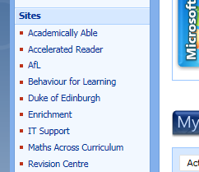
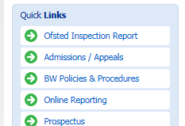
5.2 – Operational Issues - Policies and Procedures – Issue Reporting
Issue Reporting – Most Intranets have a link on them to report a network issue, but all networks have software for recording their own issues. Tracking through network logs, web logs, email logs etc. and linking this through the portal allows a network manager to allocate resources and staff to repairs as they happen. For instance a printer log will tell the system when the cartridge is running low or paper is running out, a linked version will then order a replacement.
Similarly a web log records activity, looks at patterns, checks visited sites for issues and puts into place protocols that block them or caches them.
Staff reporting of issues pre-empts this, reducing down the need to wait for a fault report and allows a quicker turnover of repairs. Good business practice is to take advantage of both of these, personal and log, in order to reduce downtime, improve efficiency and alleviate staff stress.
Click here and here for examples of how abusing Issue Reporting can affect the reputation and finances of a company.
Task 18 – Using 2 different business models and the Report Template, define the Companies Policy on User Responsibility and Issue Reporting procedures.
User responsibility |  | Issue reporting
Business 1 | Business 2 | Business 1 | Business 2

Slide 35
5.2 – Operational Issues – Change Management
Change within the IT world is inevitable, better hardware, updated software, equipment obsolescence etc.
Change Management is an IT service management discipline. The objective of change management in this context is to ensure that standardised methods and procedures are used for efficient and prompt handling of all changes to control IT infrastructure, in order to minimize the number and impact of any related incidents upon service.
Changes in the IT infrastructure may arise reactively in response to problems or externally imposed requirements, e.g. legislative changes, or proactively from seeking improved efficiency and effectiveness or to enable or reflect business initiatives, or from programs, projects or service improvement initiatives.
Change Management can ensure standardised methods, processes and procedures which are used for all changes, facilitate efficient and prompt handling of all changes, and maintain the proper balance between the need for change and the potential detrimental impact of changes.
Morals means personal responsibility, ethics means a nations moral responsibility If you store one music file you are breaking the law. Watching something in a room with more than 5 people without licence is breaking the law Singing a song out loud is breaking the law. Find one student in the room who is not breaking the law.

Slide 36
5.2 – Operational Issues – Change Management
Change management applies a formal process to accomplish change and therefore is sometimes thought of as making change more difficult by adding “red tape.” But a properly implemented change management process can enable a greater volume of useful change than would be possible without it. It does so in the following ways:
By assuring that all proposed changes are evaluated for their benefits and risks, and that all impacts are considered.
By prioritizing changes so that limited resources are allocated to those changes that produce the greatest benefit based on the business need.
By requiring that all changes are thoroughly tested and that each deployment includes a back-out plan to restore the state of the environment in the event that the deployment fails.
By ensuring that the configuration management system is updated to reflect the effect of any changes.
There are two important tools for accomplishing this:
Change models - It is extremely rare that a proposed change is not similar to changes made in the past. The change manager can develop a change model to standardize the procedure for implementing a specific type of change. This streamlines the process and reduces the risk of change.
Standard changes - A standard change is a special case of a change model and applies to routine changes involving little risk. Standard changes are pre-approved, meaning that they do not have to be reviewed by change management and are typically treated as service requests by the service desk.
Task 19 – Your school will change the IT suite’s old computers in the Summer, Describe the policy needed to do so, the stages taken, the procedures that should be in place and the expected result of this change.

Slide 37
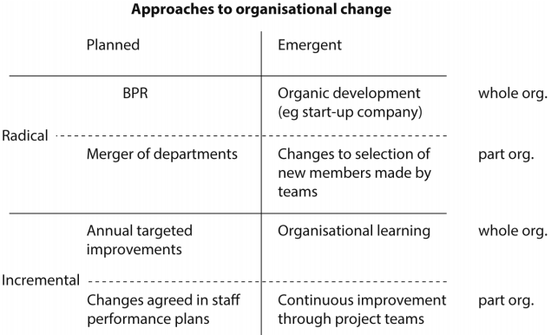
5.2 – Operational Issues – Scale of Change
There are three levels of strategic change. Firstly, organisation specific changes, such as a new information system. Secondly, generic organisation-wide change programs, such as business process engineering and thirdly, generic multi-organisational change programs, for example, mergers and acquisitions.
It must be borne in mind that whilst radical and incremental change may be defined and measured, that often it is the perceived scale of change that may be more important than
the ‘actual’ scale of change.
Planned or Unplanned
Whilst it may be assumed
that all organisational
change is both rational
and planned, with control
of nearly all processes
and resources, there
may be occasions when
a less planned and logical
method may be adopted.
Task 20 – Describe how the scale of change might affect the school in replacing its redundant ICT equipment.
Morals means personal responsibility, ethics means a nations moral responsibility If you store one music file you are breaking the law. Watching something in a room with more than 5 people without licence is breaking the law Singing a song out loud is breaking the law. Find one student in the room who is not breaking the law.

Slide 38
5.2 – Operational Issues – H&S
The use of computers in the home and business world has increased dramatically over the last few years. This increase brings its own physical dangers, which can cause hard to users unless they take some very simple precautions.
Health aspects
Health and safety regulations advise that all computer systems have at least tiltable and anti-glare screens, adjustable chairs and foot supports, suitable lighting and uncluttered work stations, and recommend frequent breaks and frequent eye tests.
Below is a list of a number of health risks as well as giving some idea of how each risk can be removed or minimized.
Health Risk | Ways of eliminating or minimizing risk
Back and Neck Problems/strain Caused by sitting in front of the computer screen for long periods in the same position | Use fully adjustable chairs to give the correct posture Use foot rests to reduce posture problems Use screens that can be tilted to ensure the neck is at the right angle.
Repetitive Strain Injury (RSI) Damage to fingers and wrists by continuous use of keyboard or repetitive clicking of mouse buttons for example. | Ensure correct posture is maintained (i.e. correct angle of arms to the keyboard and mouse for example) Make proper use of a wrist rest when using a mouse or a keyboard Take regular breaks (and do some exercise) Make use of ergonomic keyboards Use voice-activated software is the user is prone to problems using a mouse and keyboard

Slide 39
5.2 – Operational Issues – H&S
Health Risk | Ways of eliminating or minimizing risk
Eyestrain Caused by staring at a computer screen too long or having incorrect lighting in the room. | Ensure that there is no screen flicker as this can lead to eye problems Change to LCD screens where flicker is less of a problem than with CRT screens Take regular breaks (and try focusing on a point that is some distance away) Make sure of anti-glare screens if lighting in the room is incorrect or use window blinds to reduce sunlight reflecting from the screen Users should have their eyes tested on a regular basis (middle vision glasses should be prescribed if the user has a persistent problem such as eye strain, dry eyes, headaches etc.)
Headaches Caused by incorrect lighting, screen reflections, flickering screens etc. | Use an anti-glare screen or use window blinds to cut out reflections (incorrect lighting can cause squinting and lead to headaches) Take regular breaks (and do some exercise) Have your eyes tested regularly and use middle vision glasses if necessary
Ozone Irritation Caused by laser printers in an office area (dry skin, respiratory problems etc.) | Proper ventilation should exist to remove the ozone gas as quickly as possible Laser printers should be housed in a designated printer room Change to other types of printer if necessary (e.g. inkjet printers)

Slide 40
5.2 – Operational Issues – H&S
Safety is a different issue to health, health is more general on how to stop people becoming ill or being affected by daily contact with computers. Safety is more concerned with dangers that could lead to serious injury or even loss if life. Some of the more common examples of safety risks, together with possible solutions, are listed below:
Safety Risk | Ways of eliminating or minimizing risk
Electrocution | Use an RCB (residual Current Breaker) Check insulation or wires regularly Don’t allow drinks near computers Check equipment on a regular basis
Trailing wires (trip hazard) | Use cable ducts to make the wires safe Cover wires and/or have them neatly tucked away (under desks etc.) Use wireless connections whenever possible, thus eliminating wires
Falling equipment causing injury | Use strong desks and tables to support heavy hardware Use large desks and tables so that hardware isn’t too close to the edge where it can fall off.
Fire risk | Have a fully tested CO2/dry fire extinguisher nearby (not water extinguishers) Don’t cover equipment vents (causing equipment to overheat) Make sure that the electrics used in the hardware is fully maintained (i.e. portable appliance tested) Ensure good ventilation in the room (stops hardware overheating) Don’t overload sockets with too many items. Change to low-voltage hardware wherever possible (e.g. replace CRT monitors with LCD ones)

Slide 41
5.2 – Operational Issues – H&S
In spite of the previous ways of reducing or eliminating the health and safety risks, the individual still has an important role to play. In the home, the user needs to have a good health and safety strategy, and to carry out the following checks on a regular basis:
Check the state of the wires/cables and plugs (check whether any wires are damaged, make sure there is no loose wires in the plugs and make sure the plug isn’t broken or cracked)
Make sure that drinks (such as tea or coffee) are well away from the computer
Fix wires along walls and behind desks wherever possible to remove the risk of wires coming into contact with people.
Don’t cover computers with paper or fabrics, e.g. towels or sheets) since these can either block ventilation holes (causing computers to overheat) or these materials could catch fire.
Don’t plug too many devices into an electric socket outlet – overloading a socket can cause a fire.
Make sure you exercise every hour or so to prevent the health risks outlined becoming a real issue.
Carry out an ‘ergonomic’ assessment on your work station (there are numerous online questionnaires that will enable you to check whether your work station is set up properly for your own health and safety); it may require sitting in front of screens or typing for long periods at a time.
Task 21 – Create a risk assessment of the room you are currently in, scaling the dangers from Low, Medium and High.
What is Ergonomics Why does the school not supply us with this stuff How annoying is a printer noise. How many decibels is the average computer room? Do I need a break yet, it has been an hour. Gamers thumb, elbow, goggle eyed syndrome.

Slide 42
5.3 - Threats
E-Safety also refers to the benefits, risks and responsibilities when using ICT. The following list gives some ideas of the e-safety issues that can be encountered by users of ICT hardware:
Don’t give out any personal information to people whoa re unknown to you; this is especially true online where it isn’t possible to physically meet people so that their motives can be fully assessed. Remember that anyone can say anything they want online and it is very difficult to determine whether they are genuine or not
Don’t send people photos to determine whether they are genuine or not – unless the person is known to you (it is very easy for someone to pass these photos on or even pretend to be you for a number of reasons); this is a particularly large risk on social networking sites
Always maintain your privacy settings on whatever device is being used online or during communications. Privacy settings allow the user to control which cookies are stored on their computer or they enable the user to decide who can view certain information about them on a social networking site.
What is Ergonomics Why does the school not supply us with this stuff How annoying is a printer noise. How many decibels is the average computer room? Do I need a break yet, it has been an hour. Gamers thumb, elbow, goggle eyed syndrome.

Slide 43

5.3 – Threats – Internet Use
When accessing the Internet, make sure the websites visited can be trusted (two common ways of checking this is to look for https or the padlock sign); when using search engines, always make sure the device settings are set to ‘safe search’ and the highest possible level of security is used.
Only use websites recommended by teachers and inly use a learner friendly search engine.
Only open emails from known sources, It is always a good idea to make sure your Internet Service provider (ISP) has an effective email filtering feature to ensure unknown emails are placed in the spam box
Only email people you know, Think carefully before opening any email and never include the school’s name or photos of a student wearing a school uniform in an email.
It is extremely important to be vigilant when using social networking sites, instant messaging or chat rooms:
Block or report anyone who acts suspiciously or who uses inappropriate language and avoid the misuse of photos and always use appropriate language
Be careful of the language used in chat rooms and always use a nickname, never your real name.
Keep private and personal data secret and Always respect people’s confidentiality.
Don’t enter private chat rooms – stay public (the danger signs in a private chat are: somebody sounds too good to be true, they ask you to go to instant messaging and then to emails, they request your telephone number and then finally suggest you meet)
Never arrange to meet anyone for the first time on your own, Always tell an adult first and meet the person in a public place.

Slide 44
5.3 – Threats – Online Security
It is also important to be careful when using online gaming since this carries its own risks. Many users think that all players are like minded and thus there are no real risks associated with this type of communication. Some of the known risks reported over the years include:
Violence in the game itself, which can lead to violent behavior in reality
Predators (people who prey on others who they see as vulnerable)
Cyber bullying (the use of electronic communication to bully a person, typically by sending intimidating or threatening messages)
Use of webcams (the risks are obvious)
Voice masking technology (to disguise a voice so you can’t tell their sex or age, or even their accent)
It is often overlooked that online games are also a source of cyber attacks on a user’s computer or mobile phone – viruses, phishing or spyware are well-reported examples of problems associated with certain online gaming.
Task 22 – Find out what safety measures should be taken when playing games on the Internet. Write an article on these safety measures and also include ways to minimise or remove these risks.

Slide 45
5.3 – Threats – Security of Data
The previous list is by no means exhaustive but gives some idea of the risks associated with using computers and tablets online. It also indicated that gaming and the use of mobile phones carry equal risks. Basically any device that allows communication (either through the Internet, via phone networks or even via wireless communications) has a number of associated risks. As long as users take simple precautions, the risks are considerably minimised and ICT can be used to the full.
Security of Data
There are a number of security risks associated with any electronic device that connects to a network (internet or mobile phone networks being the most common). The following risks will be covered:
 hacking  phishing
 smishing  vishing
 pharming  spyware
 viruses  spam
 cookies
 moderated and unmoderated forums
Each security risk, together with its description, possible effects and how to minimise it are set out in diagram 8.1
Description of the security risk
Name of the security risk
Possible effect of the security risk
Methods to help remove the security risk

Slide 46
5.3 – Threats – Data Security - Hacking
This is the act of gaining unauthorized access to a computer system
CRACKING
is very often confused with hacking – cracking is where someone edits the source code of a program (allowing it to be exploited or changed for a specific purpose) It is usually done for a malicious purpose (e.g. to perform a different task, such as send a user to a fake website) Cracking is also illegal and very damaging.
This can lead to identity theft or the misuse of personal information
Data can be deleted, changed or corrupted on a user’s computer
Hacking
Use of encryption won’t stop hacking – it makes the data unreadable to the hacker but the data can still be deleted or corrupted.
Use of Firewalls
Use of strong (frequently changed passwords and user ID’s,
Use of intrusion detection software
Use of User IDs and Passwords
Figure 8.2 - Hacking

Slide 47
5.3 – Threats – Data Security - Phishing
The creator sends out legitimate looking emails to target users. As soon as the recipient clicks on a link in the email or attachment, they are sent to a fake website or they are fooled into giving personal data in replying to the email. The email often appears to come from a trusted source, such as a bank or well known service provider.
The creator of the email can gain personal data, such as bank account data or credit card numbers, from the user.
Phishing
Phishing emails
often look legitimate by copying large companies, such as online stores, to try to convince users that the email is totally authentic
Many ISP’s or web browsers filter out phishing emails.
Users should always be cautious when opening emails or attachments.
Don’t click on executable attachments that end in .exe, .bat, .com, or .php.
Figure 8.3 - Phishing

Slide 48

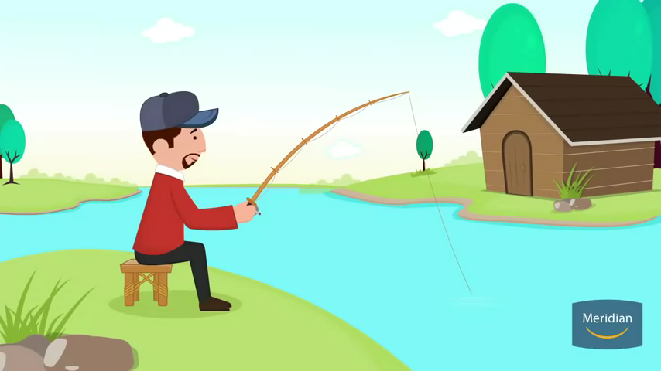
5.3 – Threats – Data Security - Phishing
Malicious use refers to, for example, deletion, fraud, identity theft and selling on personal data. A good example if a phishing attack is when a user is sent an email saying they have ordered an item from an online store. They will be asked to click on a link to see their order details. The link take the user to a page that shows a product code from a well known company. A message such as ‘if this order wasn’t made by you, please fill out the following form to cancel your order in the next 24hours’ is given. The form will ask for details such as credit card number, user’s address and so on. Some of the key clues are that links, such as how to ‘contact us’ don’t work.
What is Ergonomics Why does the school not supply us with this stuff How annoying is a printer noise. How many decibels is the average computer room? Do I need a break yet, it has been an hour. Gamers thumb, elbow, goggle eyed syndrome.

Slide 49
5.3 – Threats – Data Security - Smishing
Smishing – short for SMS phishing – uses the SMS system of mobile phones to send out fake text messages, similar to phishing. These scams often use a URL or telephone number embedded in the text message. The recipient will be asked to log on to the website or make a telephone call. If they do, they will be asked to supply personal details such as credit card numbers or passwords. As with phishing attacks, the text message will appear to come from a legitimate source and will make a claim, i.e. that they have won a prize or that they need to contact their bank urgently. Most people believe that only computers are liable to security threats; mobile phones aren’t at risk. This makes smishing a particularly dangerous security threat to many people.
Vishing (voice mail phishing) – is another variation of phishing. This uses a voice mail message to trick the user into calling the telephone number contained in the message. As with all phishing attacks, the user will be asked to supply personal data thinking they are talking to a legitimate company.
Smishing example Vishing example
What is Ergonomics Why does the school not supply us with this stuff How annoying is a printer noise. How many decibels is the average computer room? Do I need a break yet, it has been an hour. Gamers thumb, elbow, goggle eyed syndrome.

Slide 50
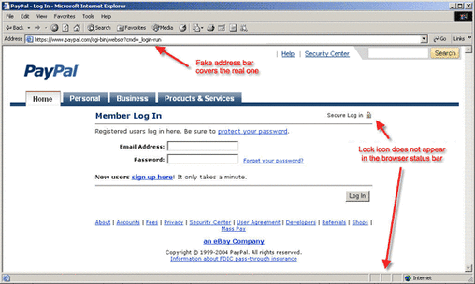
5.3 – Threats – Data Security - Pharming
This is malicious code installed on a user’s computer or on a web server, the code will redirect the user to a fake website without their knowledge (the user doesn’t have to take any action, unlike phishing)
The creator of the malicious code can gain access to personal data such as credit card details from users when they visit the fake website, usually the website appears to be that of a well known or trusted company.
Pharming can lead to fraud or identity theft.
Pharming
The user
should look for clues that they are being connected to a secure website, they should look out for https in the URL or use the padlock symbol.
Some anti-spyware software can identify and remove pharming code from a user’s computer
The user should always be alert and look out for clues that they are being redirected to another website.
Figure 8.4 - Phishing

Slide 51
5.3 – Threats – Data Security – Spyware and Keylogging
This is software that gathers data by monitoring key presses on the users keyboard, the gathered data is then sent back to the person who sent the software.
Software given the originator access to all data entered using a keyboard on the user’s computer
The software is able to install other software, read cookie data, and also change a user’s default browser.
Spyware and key-logging software
Banks
often use drop down menus where the user enters certain characters from their password using a mouse of touch screen, the required characters are also changed every time the user logs into their account to stop hackers gathering the full password.
Use anti-spyware software to reduce the risk
The user should always be alert and check for clues that their keyboard activity is being monitored.
When entering a password, for example, using a pointing device (or touch screen) to select characters from a drop-down menu can reduce the risk.
Figure 8.4 – Spyware and Key Logging

Slide 52
5.3 – Threats – Data Security - Viruses
This is program code or software that can replicate/copy itself with the intention of deleting or corrupting files on a computer, they often cause the computer to malfunction (for example, by filling up the hard drive with data)
Activity 8.3 – research and describe the following viruses:
Melissa
Iloveyou
Sobor Worm
Lovesan
Present the information stating:
What it did
How it worked
The damage caused
Viruses can cause the computer to ‘crash’, stop functioning normally or become unresponsive (e.g. the user get the ‘not responding’ message.
The software can delete files or data on the computer
The software can corrupt operating system files, making the computer to run slowly or ‘crash’.
Viruses
Backing up
files won’t guard against the effect of viruses, the virus may have already attached itself to the files that are being copied to the backup system, when these files are then copied back to the computer, the virus is simply reinstalled.
Use anti-spyware software to reduce the risk
Install anti-virus software and update it regularly.
Don’t use software from unknown sources.
Be careful when opening emails or attachments from unknown senders.
Figure 8.4 – Viruses

Slide 53
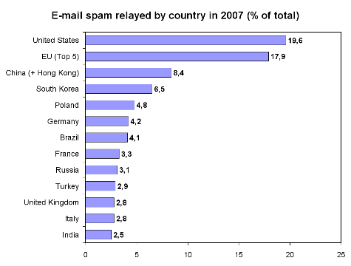
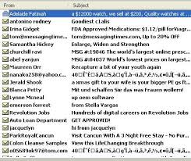
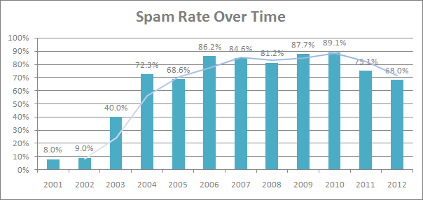
5.3 – Threats – Data Security - Spam
Spam – Often referred to as ‘junk mail’, is usually sent out to a recipient who is on a mailing list or mailing group. Spammers obtain these email addresses form chat rooms, websites, newsgroups and even certain viruses that have been set up to harvest a user’s contact list.
While spam is rarely a security risk but can lead to denial of services, by ‘clogging up’ the bandwidth on the internet. DOS is basically an attach on a network that is designed to slow the network down by flooding it with useless traffic. However, spam can be linked to phishing attacks or even the spreads of computer viruses, so it should be treated with caution.
Many ISP’s filter out spam and junk mail. However some of the more overactive ISP’s can filter out ‘wanted’ emails that come from new sources.
The Law in Britain now states that all tick boxes state ‘No’ when the site loads. 95% of all emails sent in the world are Spam Clicking on ‘Enable or download Images’ basically means you are looking at their website. Still waiting for my Oil money.

Slide 54
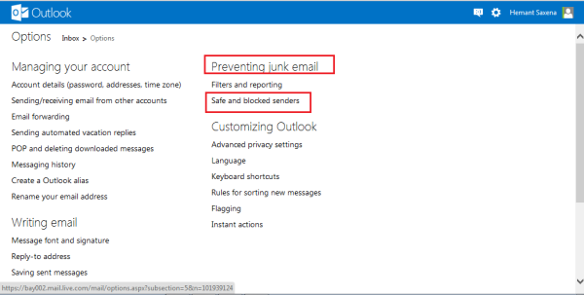
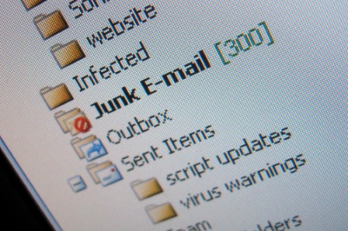
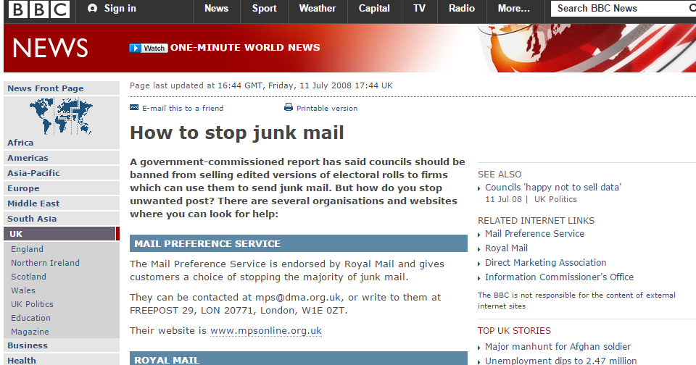
5.4 - Digital Security – Spam Filter
Spam prevention techniques
To obtain the maximum protection possible when using the ‘junk email filter’ set the protection level to high or to safe lists only. Make sure the junk mail filter is kept up to date.
Block images in HTML messages that spammers use as web beacons (a web beacon can be a graphic image, linked to an external web server, that is placed in a HTML-formatted message and can be used to verify that you email address is valid when the message is opened and images downloaded)
Look out for checkboxes that re already selected when items are bought online; companies sometimes add a preselected checkbox to indicate that you have agrees to sell or give your email address to third party users, make sure that this check box is ‘unticked’ so that your email address can’t be shared.
Do not sign up to commercial mailing lists.
Do not reply to an email or unsubscribe from a mailing list that you did not explicitly sign up t in the first place.
The Law in Britain now states that all tick boxes state ‘No’ when the site loads. 95% of all emails sent in the world are Spam Clicking on ‘Enable or download Images’ basically means you are looking at their website. Still waiting for my Oil money.

Slide 55
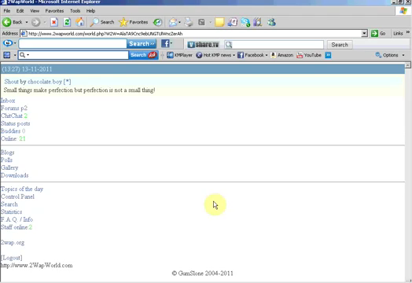
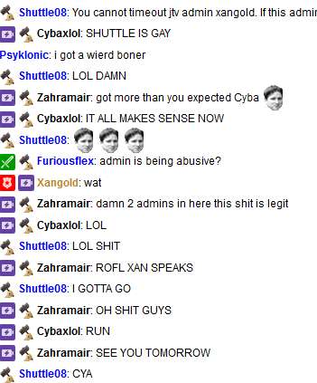
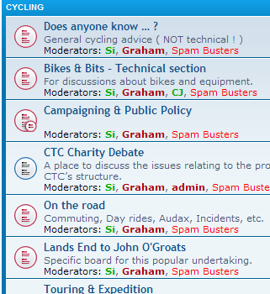
5.4 - Digital Security – Forum Moderation
A Moderated Forum refers to an online discussion forum in which all the posts are checked by an administrator before they are allowed to be posted. Many users prefer this type of forum, compared to an unmoderated one, as the moderator can not only prevent spam, but can filer out any posts that are inappropriate, rude or offensive, or wander off the main topic.
The internet is essentially an unmoderated forum. No-one ‘owns’ the Internet and it is essentially not policed. The only real safeguards are a voluntary cooperation between users and the network operators. However most social forums or networking groups on the internet have a set of rules or protocols that members are requested to follow or they will be deleted.
Game sites like Twitch are unmoderated Forums are more that merely leaving comments Forums have been around as long as the Internet. There is a forum for everything. Fan Fiction is a form of forum. Twitter to a degree is a form of forum.

Slide 56
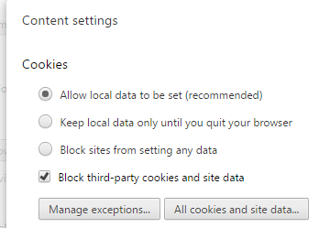
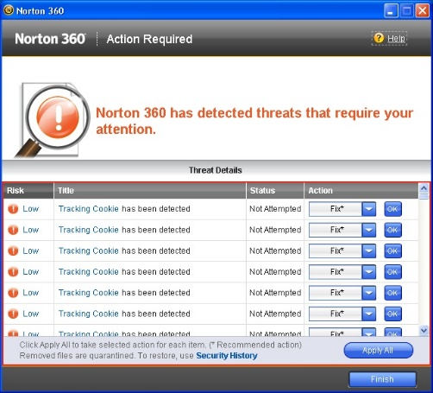

5.4 - Digital Security – Cookies
Cookies – These are small files or code that are stored on the users computer sent by a web server. Each cookie is effectively a small look-up table, containing pairs of (key, data) values, i.e. (surname, Jones) and (music, Rock). Once the cookie has been read by the code on the web server or user’s computer, the data can be retrieved and used to customize the webpage for each individual. These are often referred to as User Preferences, e.g. when a user buys a book online, the user remembers the type of book the user chose and the web page will then show a message such as: ‘Customers who bought The Hobbit also bought Lord of the Rings’.
The data gathered by the cookies form an anonymous user profile and doesn’t contain personal details such as passwords or credit card numbers. Cookies are a very efficient way of carrying data from one website session to another or even between sessions on related websites. They remove the need to store massive amount of data on the web server itself. Storing data on the web server itself would make it very difficult to retrieve a user’s data without requiring the user to log in every time they visit the site.
Solution: Use of secure servers is always advised. A secure web server is one that supports any of the major security protocols, such as SSL/TLS, that encrypt and decrypt messages to protect them against third party eavesdroppers. Making purchases from a secure server ensures that a user’s payment or personal information can be translated into a secret code that’s difficult to break.

Slide 57
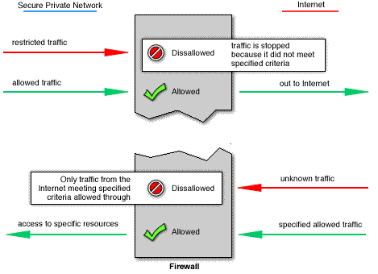
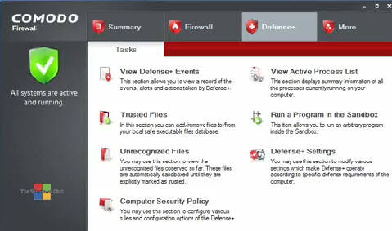

5.4 - Digital Security – Firewalls
Firewall (Software) – This is either software or hardware and sits between the user’s computer and an external network (i.e. the internet) and filters information coming in and out of the user’s computer. The following list are tasks carried out by the firewall:
To examine the ‘traffic’ between a user’s computer (or internal network) and a public network (i.e. the Internet)
Checks whether incoming or outgoing data meets a given criteria.
If the data fails the criteria, the firewall will block the traffic and give the user (or network manager) a warning that there may be a security issue.
The firewall can be used to log all incoming and outgoing traffic to allow later interrogation by the user
Criteria can be set up so that the firewall prevents access to certain undesirable IP addresses.
Firewalls can help prevent hackers or viruses from entering or gaining access to the users network. This can be done by blocking IP addresses but hackers can still access the network if they use allowed computers.
If the user is warned if some software on their system is trying to access an external data source (i.e. an automated software upgrade); the user is given the option of allowing or denying the request.

Slide 58
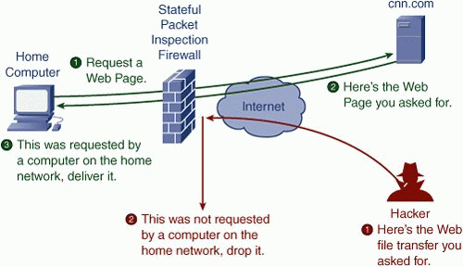

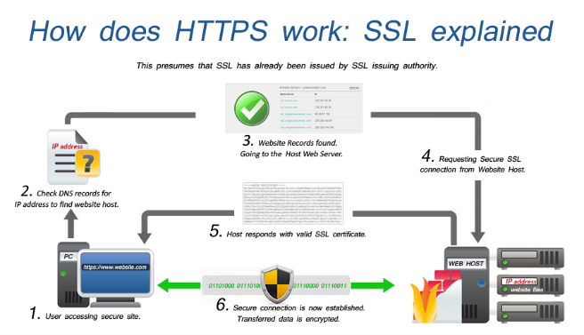
5.4 - Digital Security – Firewalls
User’s Computer
Firewall (software or hardware)
Internet
Firewall (Hardware) – The firewall can be a hardware interface that is located somewhere between the computer and the internet connection, in which case it is often referred to as a gateway. Alternatively, the firewall can be software installed on a computer; in some cases this is part of the operating system.
However there are certain circumstances where the firewall can’t prevent potential harmful traffic:
It cannot prevent individuals, on internal networks, using their own modems to bypass the firewall.
Employee misconduct or carelessness cannot be controlled by firewalls (i.e. control of passwords or user accounts)
Users on stand alone computers can chose to disable the firewall, leaving their computer open to harmful traffic from the Internet.
All of these issues require management control (or personal control on a single computer) to ensure that the firewall is allowed to do its job effectively.

Slide 59
5.4 - Digital Security – Security Protocols
Protocols means a set of rules used by computers to communicate with each other across a network or using the Internet. There are 2 we will need to know:
Secure Socket Layer (SSL) – This is a type of protocol that allows data to be sent and received securely over the Internet.
When a user logs on to a website, SSL encrypts the data – only the user’s computer and the web server are able to make sense of what is being transmitted. A user will know is SSL is being applied when they see https (as part of the website address) or the small padlock in the status bar at the top of the screen. Figure 8.8 below shows what happens when a user wants to access a secure website and send data to it.
The user’s web browser sends a message so that it can connect with the required website, which is secured with SSL
The web browser requests that the web server identifies itself
The webserver responds by sending a copy of its SSL certificate to the users web browser
Once the message is received, the web server acknowledges the web browser and the SSL-encryption two-way data transfer begins.
If the web browser can authenticate this certificate, it sends a message back to the web server to allow communication to begin.
Figure 8.8 – Communicating across a network using SSL
Note: SSL certificates are small data files that digitally bind an encryption key to an organisation’s details. When installed on a web server, it shows as the green padlock and the https protocol and ensures secure connections from a web server to a web browser.

Slide 60
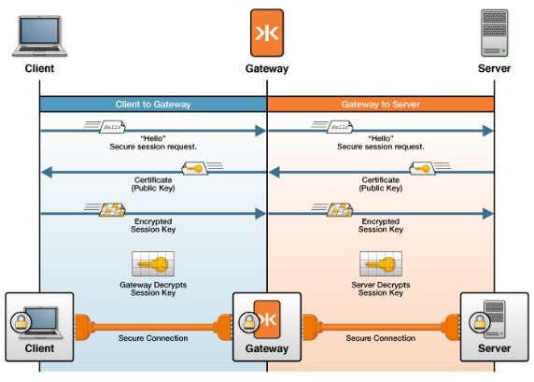
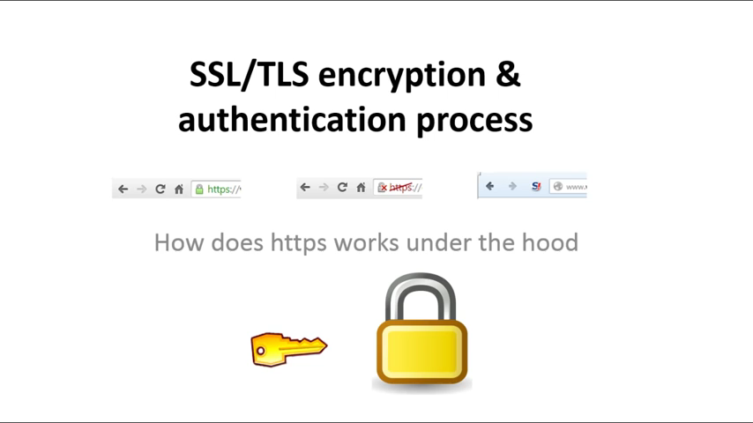
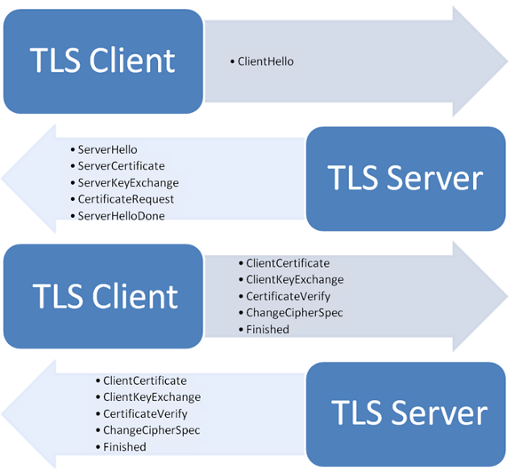
5.4 - Digital Security – Security Protocols
Transport Layer Security (TLS) is similar to SSL but is a more recent security system. TLS is a form of protocol that ensures the security and privacy of data between devices and users when communicating over the Internet. It is essentially designed to provide encryption, authentication and data integrity (maintaining the accuracy and the consistency of data) un a more effective way than SSL.
TLS is formed in two layers:
Record protocol – part of the communication can be used with or without encryption (it contains the data being transferred over the Internet)
Handshake Protocol - permits the website and the user to authenticate each other and to make use of encryption algorithms (a secure session (port) between user and website is established).
Only the most recent web browsers support both SSL and TLS which is why the older SSL is still used in many cases. But what are the main differences between SSL and TLS since they both do the same thing:
It is possible to extend TLS by adding new authentication methods.
TLS can make use of Session Caching, which improves the overall performance compared to SSL.
TLS separates the handshaking process from the record protocol (layer) which holds all the data.

Slide 61
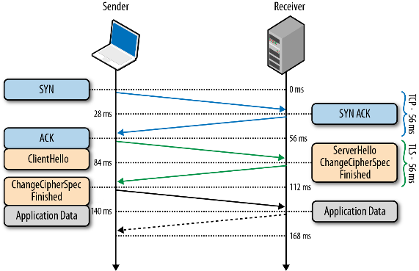
5.4 - Digital Security – Encryption
Session Caching – When opening a TLS session, it requires a lot of computer time (due mainly to the complex encryption keys being used). The use of session caching can avoid the need to use so much computer time for each connection. TLS can either establish a new session or attempt to resume an existing session, using the latter can boost system performance.
Note: a cache is a collection of processed data that is kept on hand and reused in order to avoid costly repeated database queries.
Encryption – Used primarily to protect data in case it has been hacked or accessed illegally. While encryption will not prevent hacking, it makes the data meaningless unless the recipient has the necessary decryption tools.
Encryption uses a secret key that has the capability of altering the characters in a message. If this key is applied to a message, its content is changed, which then makes it unreadable unless the recipient also has the same secret key. When the key is applied to the encrypted message, it can be read.
The key used to encrypt (encode) the message is called the encryption key; the key used to decrypt (decipher) the message is knows as the decryption key. When a message undergoes encryption it becomes cypher script, the original message is known as plain text. Figure 8.9 shows how these link together.
Encryption Key
Encryption process
Cypher Script
Plain Text
Figure 8.9 - Encryption

Slide 62
5.4 - Digital Security – Encryption
Sender
“YM3G 3G 1 N2GG1R2 FV3YY2P 3P DX13P Y2LY T2Z4V23Y R42G YMV45RM YM2 2PKVHDY34P DV4K2GG’
Research SS-Trans What is 32bit, 64bit and 128bit encryption How long would a hacker take to break a 128bit encryption code? Is this how hackers do it? What is the Dark Web? Research Phreaking What is the worst that could happen
Encryption Key
This is a message written in Plain Text before it goes through the encryption process
Encryption process
Receiver
“YM3G 3G 1 N2GG1R2 FV3YY2P 3P DX13P Y2LY T2Z4V23Y R42G YMV45RM YM2 2PKVHDY34P DV4K2GG’
This is a message written in Plain Text before it goes through the encryption process
Decryption process
Decryption Key
Figure 8.10 – Example of the encryption and decryption process

Slide 63
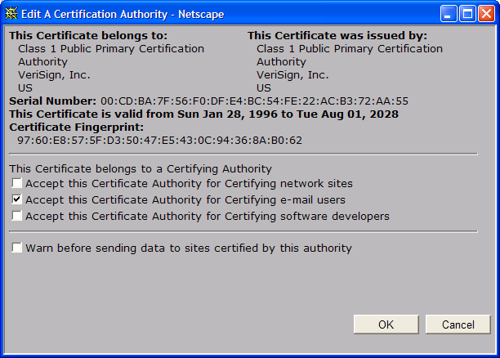
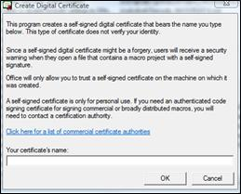

5.4 - Digital Security – Authentication
Authentication – used to verify that data comes from a secure and trusted source. It works with encryption to strengthen internet security. This is done in several ways:
Digital Certificates – this is a pair of files stored on a user’s computer – these are used in the security of data sent over the internet. Each pair of files is divided into:
A public key (which is known by anyone)
A private key (known to the computer user only).
For example, when sending an email, the message is made more secure by attaching a digital certificate. When a message is received, the recipient can verify that it comes from a known and trusted source by viewing the public key information (usually part of the email attachment). This is an added level of security to protect the recipient from harmful emails. The digital certificate is made up of 6 parts:
The sender’s email address
The name of the digital certificate owner
A serial number
Expiry date (the date range during which the certificate is valid)
Public key (used for encrypting messages and for digital signatures)
Digital signature of certificate authority (CA) such as Verisign.
Operating systems and web browsers maintain lists of trusted CA’s.

Slide 64
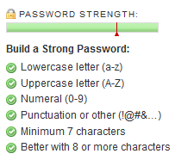
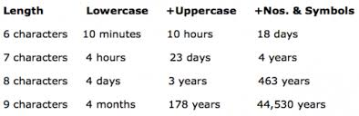
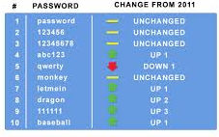
5.4 - Digital Security – Passwords
Passwords – When logging on to a system such as a bank website, a user will be asked to type in their password – this should be a combination of letters and numbers that would be difficult for somebody to guess. Strong passwords should contain upper and lower case, numbers, special symbols – e.g. R5a#nk2.
When the password is typed in, it often shows on the screen as ****** so no-one overlooking can see what is being typed. If the user’s password does not match up with the user’s ID then access will be denied.
Many systems ask for the password to be typed in twice as a verification check (check on input errors). To help protect the system users are only allowed to type in their password several times, usually 3, before the system locks the user out. After that, the user will be unable to log on until the system administrator has reset their password.
I.E. is a user forgets their password when using the internet, they can request that their password is sent to their email address. The password is never shown on the screen for security reasons.
Passwords should be changed on a regular basis in case they become known to another user or hacker, in particular in case of spyware or viruses.
It is often necessary to use a User ID or login ID as well as a password. This gives an additional security level since the user ID and password must match up.
FACT: The worst passwords remain relatively consistent from year-to-year. Here are the list of the Top 10 Worst Passwords of 2012 and how they compare.

Slide 65
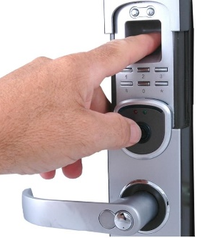
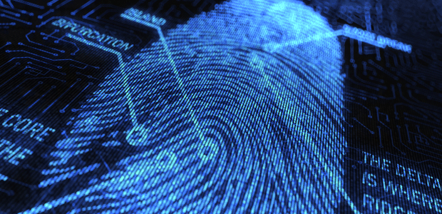
5.4 - Digital Security – Biometrics
Biometrics – These rely on certain unique characteristics of human beings, i.e.:
 Fingerprint scans  Signature recognition  Retina scans
 Iris recognition  Face recognition  Voice recognition
Biometrics is used in a number of applications as a security device, i.e. some of the latest mobile phones use fingerprint matching before they can be operated; some pharmaceutical companies use face recognition or retina scans to allow entry to secure areas.
Fingerprint Scans – Images of fingerprints are compared against previously scanned fingerprints stored in a database; if they match then access is allowed. The system compared patterns of ‘ridges’ and ‘valleys’, which are fairly unique (accuracy is about 1 in 500)
An example of this would be a security method for entering a building. Fingerprint scanning techniques have the following application advantages:
Everybody’s fingerprints are unique, therefor this technique would improve security since it would be difficult to replicate.
Other security devices (such as magnetic cards) can be lost or stolen, which makes them less effective.
It would be impossible to ‘sign in’ for someone else since the fingerprints would
match up to one person only in the database
Fingerprints can’t be misplaced.
Disadvantages include:
Relatively expensive to install and set up
If a person’s fingers are damaged through an injury, this can have an effect on accuracy
Some people will regard it as an infringement of liberties.

Slide 66
5.4 - Digital Security – Biometrics
Retina Scans – These use Infrared light to scan the unique pattern of blood vessels in the retina (at the back of the eye). It is un unpleasant technique, requiring a person to sit totally still for 10-15 seconds while the scan takes place. It is very secure as nobody has yet found a way to duplicate blood vessel patterns (the accuracy is about 1 in 10m)
Table 8.3 – Comparison of the common biometric techniques.
Biometric Technique | Comparative accuracy | Comparative cost | Devices needed | Social Acceptability | What can interfere with the process
Fingerprint scans | High accuracy | Medium | Scanner | Medium | Damaged fingers (e.g. cuts)
Signature recognition | High accuracy | Medium | An optical pen | High | Signatures can change with time
Retina Scans | high accuracy | High | Digital Camera | Low | Irritation of the eye
Iris Recognition | High accuracy | High | Digital Camera | Low | Wearing of glasses
Face Recognition | Medium-Low accuracy | Medium | Digital Camera | High | Facial hair or glasses
Voice Recognition | Medium accuracy | Medium | Microphone | High | Background noise or having a cold

Slide 67
5.4 - Digital Security – Biometrics
Table 8.4 – Comparison of the advantages and disadvantages of 6 common biometric techniques.
Biometric Technique | Advantages | Disadvantages
Fingerprint scans | One of the most developed biometric techniques Very high accuracy Very easy to use Relatively small storage requirements for the biometric data created | For some people it is very intrusive since it is still related to criminal activity It can make mistakes if the skin is damaged (cuts)
Signature recognition | Non-intrusive Requires very little time to verify (about 5 secs) Relatively low cost technology | If individuals do not sign their names in a consistent manner there may be signature recognition problems High error rate (1 in 50)
Retina Scans | Very high accuracy No known way to replicate a person’s retina | It is very intrusive It can be relatively slow to verify retina scans with stored scans Very expensive to install and set up
Iris Recognition | Very high accuracy Verification time is generally less than 5 secs | Very intrusive Uses a lot of memory for the data to be stored Very expensive to install and set up
Face Recognition | Non-intrusive method Relatively inexpensive technology | It is affected by changes in lighting, hair, age and use of glasses
Voice Recognition | Non-intrusive method Verification takes less than 5 secs Relatively inexpensive technology | A person’s voice can be recorded easily and used for unauthorized access Low Accuracy An illness, e.g. a cold, can change the pitch of a voice, making absolute voice identification problematic.

Slide 68
5.4 - Digital Security – Online Fraud
Task 23 – Find out which applications use each of the biometric techniques described in this section. Consider all the advantages and disadvantages of each method and make conclusions about its suitability for the applications you found.
Online Credit Fraud – In spite of all the security systems described above, online credit fraud is still too common, It basically happens for the following reasons:
Hackers gaining access to a user’s computer using spyware, phishing or pharming; any of which can trick a user who is not particularly IT literate, the user can be tricked into giving personal details that enable hackers to gain full access to a user’s account; leading to unauthorized purchases or even removal of money from an account if it remains undetected for a few days.
The breaking of passwords through a number of techniques is an all too-familiar risk; if passwords are weak or have no encryption then it is a relatively easy task to break these passwords and allow illegal access to bank and credit card accounts.
It is always a good idea to type in a web address or URL rather than ‘copy and paste it’ from an email or other website. Sometimes the web address/URL is altered very slightly in the email and the user ends up visiting a fake website. Once they visit the fake website it is possible that they will give personal and financial details to a fraudster without the user’s knowledge – by physically typing in the web address the user will ensure they get it right and avoid such risks.
If the user is using wireless technology, it is very important for internet access to be password controlled since it is relatively easy to tap in to wireless networks without password protection.
Even large organisations can be subject to cybercrime; in recent years, the cloud and some large retail companies have been targets for hackers, which leaves customers vulnerable.

Slide 69
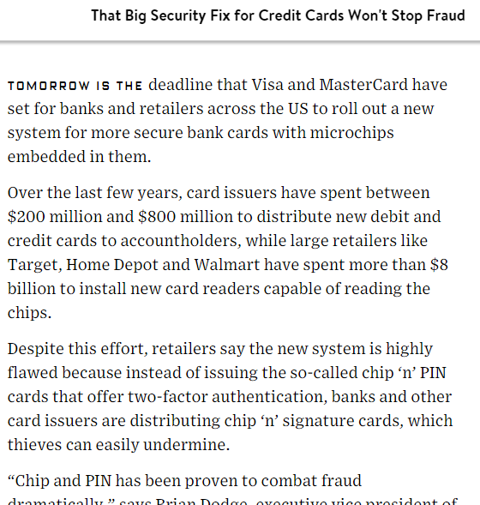

5.4 - Digital Security – Online Fraud
If a user logs into an account or website in a public place (such as an airport using the available Wi-Fi ‘hotspots’) it is necessary to be very vigilant; there’s always a risk that somebody is monitoring internet usage in the area and will try to tap in to the data that is going to and from any computer using the wireless link.
There are a number of simple precautions users can take:
Always use varied and complex passwords for all accounts
Check the accuracy of bank accounts continually and resolve any discrepancies immediately.
Only provide personal information on sites that have ‘https’ in the web address or have the padlock icon in the web browser.
Don’t provide personal information to any unsolicited requests for information; this is often a sign of phishing.
Don’t open emails or attachments from unknown senders
Delete any message from your spam folder on a regular basis
Report any suspicious phishing activity to the company that is used by the perpetrator
Only download software from sites that can be trusted.

Slide 70
5.4 - Digital Security – Cloud Security
Cloud Security – Several computers )especially tablets and laptops) and mobile phone manufacturers encourage customers to store or backup their files on a medium known as the Cloud. Users purchase cloud storage and can then access all their files (i.e. photos, videos and music) from any device anywhere in the world. This has obvious advantages:
You don’t need to carry memory sticks around with you if you want to access your files away from home
You don’t have to pay for large storage capacity on your computer/ tablet or mobile phone.
Because the cloud is controlled by external companies, they will ensure that your files are backed up and therefor reduce the possibility of losing irreplaceable data.
The ability to synchronise (sync) files ensures they are automatically updated across all devices; this means that the latest version of a file saved on a desktop PC, for example, is also available on other devices, such as a smartphone.
Cloud storage is also ideal for collaborative purposes; it allows several users to edit and collaborate on a single file or document – there is no need to worry about tracking the latest version or which user made the changes.
In spite of all these obvious advantages, there are still security worries about using cloud storage. The main fears are data security and data loss.

Slide 71



5.4 - Digital Security – Cloud Security
Data Security – Companies that transfer vast amounts of confidential data from their own systems to a cloud service provider are effectively relinquishing control of their own data security. This raises a number of questions:
What physical security exists regarding the building where the data is housed?
How good is the cloud service provider’s resistance to natural disasters or power cuts?
What safeguards exist regarding personnel who work in the cloud service company? Can they use authorization codes to access confidential data for monetary purposes?
Data Loss – There is a risk that important or irreplaceable data could be lost from the cloud storage facilities. Actions from hackers (gaining access to accounts or pharming attacks) could lead to loss or corruption of data. Users need to be certain sufficient safeguards exist to overcome these potentially very harmful risks.
In late September 2014, three breaches of security involving two of the largest cloud service providers showed why many of the above fears make people a little nervous of using this facility to store their important files.

Slide 72




5.4 - Digital Security – Cloud Security
The XEN security threat, which forced several cloud operators to reboot all their cloud servers; this was caused by a problem in the XEN hypervisor (a hypervisor is a piece of software, firmware or hardware that creates and runs virtual machines)
A recent case where a large cloud service provider permanently lost data during a routine backup procedure
The celebrity photos cloud hacking scandal, where over 100 ‘interesting’ photos of celebrities were leaked; hackers had gained access to a number of cloud accounts, which enabled them to publish the photos on social networks and to sell them to publishing companies.
All the reasons above have made individuals and companies nervous about using cloud service providers. A ‘game’ between hackers and owners of online service companies continues to simmer. Provided users are vigilant in their use of any device connected to the Internet, then the possibility of being a victim of cybercrime is considerably reduced.

Slide 73




5.5 - Safe disposal of data and computer equipment
Recycling of computer equipment is a specialist part of the waste and recycling industry. It is a rapidly growing sub-sector due largely to the implementation of the original WEEE Directive in the UK by the WEEE Regulations 2006. With that came the associated requirements for the recovery, reuse, recycling and treatment of WEEE.
Most companies replace equipment on a regular basis, a 3-year rolling policy is usual but not always possible.
Every year an estimated 2 million tons of WEEE items are discarded by householders and companies in the UK. WEEE includes most products that have a plug or need a battery. There are ten broad categories of WEEE currently outlined within the Regulations. In computer terms this means:
IT and telecommunications equipment – e.g. personal computers, copying equipment, telephones and pocket calculators
Consumer equipment e.g. radios, televisions, hi-fi equipment, camcorders ad musical instruments
Medical devices e.g. (non infected) dialysis machines, analysers, medical freezers and cardiology equipment
Monitoring and control equipment e .g. smoke detectors, thermostats and heating regulators
Printers, computers, faxes, scanners etc.

Slide 74
5.5 - Safe disposal of data and computer equipment
There is a common misconception that by deleting files or reformatting a drive, the data is gone. Wrong. Data never truly goes away . Even though there are wipe tools available to make information difficult to recover, experts in data recovery and experienced hackers know the tricks to find things such as Social Security, bank account, and credit card numbers, health and job details, and incriminating e-mail – anything that was once written and stored on the drive.
So what is the best way to dispose of unwanted computer equipment in a safe and secure manner?
Always remove the hard drive from any computer that is being sold or donated to someone else.
Never toss a hard drive or other storage device into the trash or recycling without erasing the files .
It is recommended encrypting files first, and then use an erasing tool to delete the storage device. The files might still be retrievable, but encryption ensures they will be unreadable.
The absolute safest way to dispose of an old storage device is to physically destroy it – smash it with a hammer, melt down the drive platters, submerge it in water, or drill holes through the discs so they no longer spin.

Slide 75




5.5 - Safe disposal of data and computer equipment
Task 24 – Using one of the 4 links above, describe the technical problem, the dangers involved, the potential solutions and how to avoid recurrence to the problem.

Slide 76
Exam Examples – Paper 1
November 2013 – Paper 12
1: Describe encryption and discuss the benefits and drawbacks of using it to make data secure.
________________________________________________________________________________________________________________________________________________________________________________________________________________________________________________________________________________________________________________________________________________________________________________________________________________________________________________________________________________________________________________________________________________________________________________________________________________________________________________________________________________________________________________________________________________________________________________________________________________________________________________________________________________________________________________________________________________________________ [6]
?

Slide 77
Exam Examples – Paper 1
(c) Which of these items is a biometric security method?
Item | Tick
Iris
Password
RFID
Token
?
7 Staff at Progress Mutual must sign an Acceptable Use Policy (AUP)
Describe two items that could be included in the AUP.
1: _________________________________________________________
_________________________________________________________________________________________________________________________________________________________________________________
2: _________________________________________________________
______________________________________________________________________________________________________________________________________________________________________________ [4]

Slide 78
Exam Examples – Paper 1
9 Explain the measures Progress Mutual should consider when securing customers’ data. Your answer should include physical and digital security measures.
__________________________________________________________________________________________________________________________________________________________________________________________________________________________________________________________________________________________________________________________________________________________________________________________________________________________________________________________________________________________________________________________________________________________________________________________________________________________________________________________________________________________________________________________________________________________________________________________________________________________________________________________________________________________________________________________________________________________________________________________________________________________________________________________________________ [6]
?

